Slide 1






Agricultural Raw Material Analysis
Student Details
Name: S.Sankaranarayanan
NM Id: au2021107019
College Name: College of Engineering Guindy Campus

Slide 2
Disclaimer
The content is curated from online/offline resources and used for educational purpose only

Slide 3

Course Outline
Abstract
Problem Statement
Aims, Objective & Proposed System/Solution
System Deployment Approach
Model Development & Algorithm
Future Scope
Conclusion
Reference

Slide 4


Abstract
This project conducts exploratory data analysis on a dataset of agricultural raw material prices, aiming to identify high and low-range materials and analyze their percentage change over time. By examining price fluctuations, it delineates the range of price variations across years, highlighting the most volatile and stable commodities. Through descriptive statistics and visualization, it uncovers trends and correlations among different raw materials, aiding stakeholders in risk assessment and decision-making. By mapping a heatmap of price correlations, the project visually represents interdependencies between agricultural commodities, facilitating portfolio diversification strategies. Overall, this analysis provides actionable insights for stakeholders to manage risks and optimize resource allocation in the agricultural sector.

Slide 5


Problem Statement
How do the prices of various agricultural raw materials fluctuate over time, and which commodities exhibit the highest and lowest price ranges, necessitating an understanding of their market dynamics and potential implications for stakeholders?
2. What are the percentage changes in prices for different agricultural raw materials over the years, and how do these fluctuations vary among commodities, requiring an assessment of their relative stability and volatility to inform risk management strategies?
3. Is there a discernible correlation between the price movements of different agricultural raw materials, and can these relationships be visually represented through a heatmap, enabling stakeholders to identify potential diversification opportunities and interdependencies within the market?

Slide 6

Aim and Objective
Aim: The aim of this project is to analyze historical agricultural raw material prices, identifying high and low-range commodities, assessing percentage changes over time, and mapping correlations between different materials using a heatmap, to provide insights for stakeholders in risk management and decision-making within the agricultural sector.

Slide 7
Objectives
Data Collection: Gather historical price data for various agricultural raw materials spanning multiple years from reliable sources.
Exploratory Data Analysis (EDA): Identify high and low-range commodities based on their price distributions and variability over time.
Percentage Change Analysis: Calculate the percentage change in prices for each agricultural raw material across consecutive years.
Heatmap Construction: Construct a heatmap to visualize the correlation matrix between the price movements of different agricultural raw materials.
Insights Generation: Extract actionable insights from the analysis, such as trends in price fluctuations, correlations between commodities, and potential risk management strategies.

Slide 8

Proposed Solution
Solution: The proposed solution involves rigorous data preprocessing to ensure data integrity, followed by an in-depth Exploratory Data Analysis (EDA) to uncover trends and variability in agricultural raw material prices. Percentage change calculations between consecutive years allow for the identification of price dynamics and the assessment of commodity stability. Constructing a correlation matrix and visualizing it through a heatmap enable the identification of relationships between commodities, aiding in diversification strategies. Finally, actionable insights and recommendations derived from the analysis empower stakeholders to make informed decisions regarding risk management and resource allocation in the agricultural sector.
Notes:
8

Slide 9
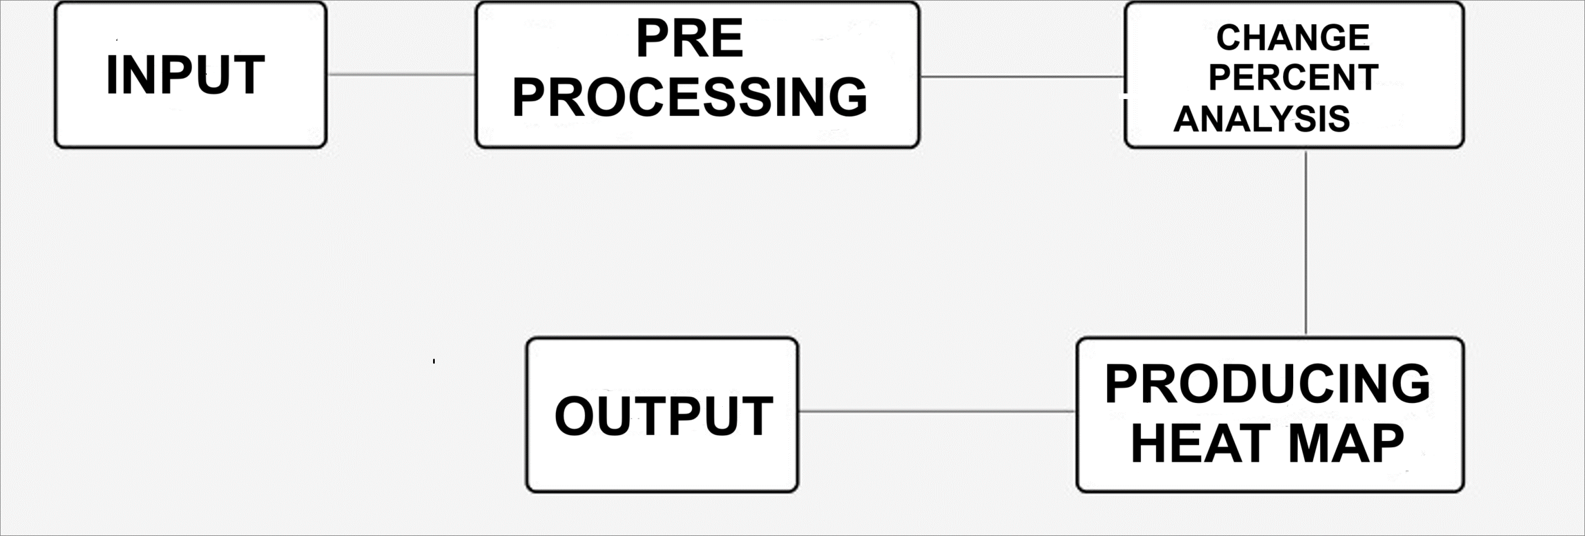
System Deployment Approach
Notes:
9

Slide 10
Model Development & Algorithm
Dataset Description:
The dataset contains raw material for agriculture.
Size of dataset is 10.4 kb
Has 11 columns
Includes corn_brl, pork_brl, chicken_brl, cult_area
Totally contains 226 rows of data
Notes:
10

Slide 11
Model Development & Algorithm
Data Preprocessing:
Handling missing values: Identify and address any missing price data points for each raw material, either through imputation techniques or removal of incomplete records.
Outlier detection and treatment: Identify outliers in price data that may skew analysis results and decide whether to remove them or apply appropriate transformations to mitigate their impact on the analysis.
Consistency checks: Ensure consistency in the format and units of price data across different raw materials and time periods to maintain data integrity.
Notes:
11

Slide 12
Model Development & Algorithm
Pre-processed Data :
date | corn_BRL | chicken_BRL | pork_BRL | cult_area | corn_prod | chicken_prod | pork_prod | inflation | int_rate | usd_brl
12/01/22 | 77.37 | 5.52 | 6.35 | 21581.0 | 112832.0 | 14850.0 | 4850.0 | 5.90 | 13.75 | 5.24
12/01/21 | 79.51 | 5.05 | 11.10 | 19944.0 | 87097.0 | 14615.0 | 4701.0 | 10.06 | 7.75 | 5.62
12/01/20 | 69.21 | 3.96 | 7.12 | 18527.0 | 102586.0 | 13787.0 | 4436.0 | 4.52 | 2.00 | 5.28
12/01/19 | 37.34 | 2.95 | 4.88 | 17493.0 | 100043.0 | 13245.0 | 4061.0 | 4.31 | 5.00 | 4.23
12/01/18 | 31.07 | 2.86 | 3.51 | 16616.0 | 80710.0 | 12855.0 | 3974.0 | 3.75 | 6.50 | 3.83
Notes:
12

Slide 13
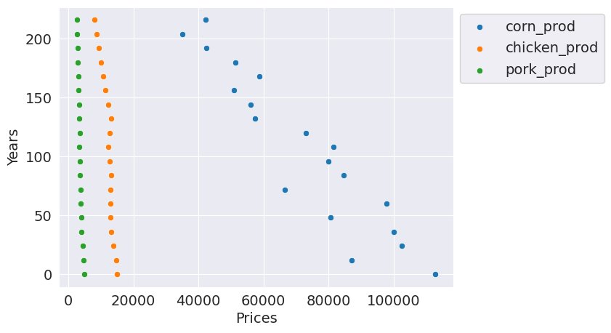
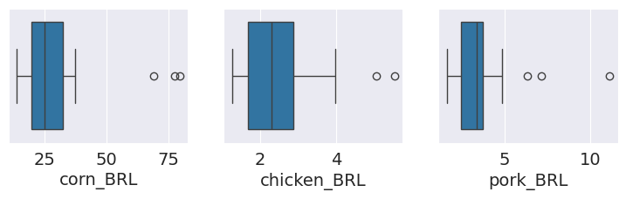
Result
Notes:
13

Slide 14

Future Scope
Enhanced Predictive Modeling: Utilize advanced machine learning techniques to forecast future price movements of agricultural raw materials with greater accuracy.
Comprehensive Market Trend Analysis: Analyze the impact of diverse factors such as technology adoption, sustainability trends, and global supply chain disruptions on agricultural raw material prices.
Dynamic Decision Support Systems: Develop interactive dashboards and AI-driven tools to provide real-time insights and support strategic decision-making processes in the agricultural sector.
Notes:
14

Slide 15

Conclusion
In conclusion, the analysis of agricultural raw
material prices has provided valuable insights into market dynamics, price trends, and interdependencies between commodities. These findings can inform stakeholders in the agricultural sector about potential risks and opportunities, enabling more informed decision-making and strategic planning. Moving forward, leveraging advanced analytics and emerging technologies will be essential to further enhance predictive capabilities, market analysis, and decision support systems in the agricultural industry.
Notes:
15

Slide 16
Reference
https://www.investing.com/commodities/
https://www.crbonline.com/
https://www.bloomberg.com/markets/commodities/agriculture
https://www.usda.gov/topics/farming
http://www.fao.org/faostat/en/#home
Notes:
Reference
These are the references for this session.

Slide 17
Thank you!
Notes:
17

